Slide 1
Conway's Game of Life Simulation in Python
Using 2D Arrays and Graph Techniques
PRESENTED BY
SARDAR HASSAN AFTAB

Slide 2
Overview of Conway's Game of Life
• Conway's Game of Life is a cellular automaton simulation.
• Cells have two possible states: alive (1) or dead (0).
• The next state of a cell depends on the number of live neighbors.
• There are four basic rules of evolution:
1. A live cell with fewer than 2 live neighbors dies (underpopulation).
2. A live cell with more than 3 live neighbors dies (overpopulation).
3. A dead cell with exactly 3 live neighbors becomes alive.
4. A live cell with 2 or 3 live neighbors remains alive.

Slide 3
Code Walkthrough
• The grid is represented as a 2D array of 0s (dead) and 1s (alive).
• Each cell's next state is determined by its 8 neighbors.
• We apply Conway's rules to update the grid each step.
• `matplotlib.animation.FuncAnimation` visualizes the grid evolving over time.

Slide 4
Grid Initialization & Neighbor Counting
• The grid is initialized randomly with 0s and 1s.
• For each cell, we count its neighbors using modular arithmetic for wrapping.
• We then apply the rules to each cell based on the number of live neighbors.

Slide 5
Visualization of Grid Evolution
• The grid evolves based on the Game of Life rules.
• We use `matplotlib` to animate the grid at each step.
• The simulation shows how patterns emerge from random initial states.

Slide 6
Animation Example
• The animation shows how the grid evolves over time.
• You can generate the animation by running the Python code.

Slide 7
Import Required Libraries
import numpy as np
import matplotlib.pyplot as plt from matplotlib.animation import FuncAnimation

Slide 8
Grid Initialization
# Initialize grid with random 0s (dead) and 1s (alive)
GRID_SIZE = 50
grid = np.random.choice([0, 1], size=(GRID_SIZE, GRID_SIZE))

Slide 9
Counting Neighbors
def count_neighbors(x, y):
neighbors = [
(x-1, y-1), (x-1, y), (x-1, y+1),
(x, y-1), (x, y+1),
(x+1, y-1), (x+1, y), (x+1, y+1)
]
return sum(grid[i % GRID_SIZE, j % GRID_SIZE] for i, j in neighbors)

Slide 10
Updating Grid
def update_grid():
new_grid = grid.copy()
for x in range(GRID_SIZE):
for y in range(GRID_SIZE):
alive_neighbors = count_neighbors(x, y)
if grid[x, y] == 1:
if alive_neighbors < 2 or alive_neighbors > 3:
new_grid[x, y] = 0
else:
if alive_neighbors == 3:
new_grid[x, y] = 1
return new_grid

Slide 11
Animation
def animate(frame):
global grid
grid = update_grid()
mat.set_data(grid)
return [mat]

Slide 12
Matplotlib Visualization
fig, ax = plt.subplots()
mat = ax.matshow(grid, cmap='binary')
ax.axis('off')

Slide 13
Running the Animation
ani = FuncAnimation(fig, animate, interval=200, blit=True)
plt.show()

Slide 14
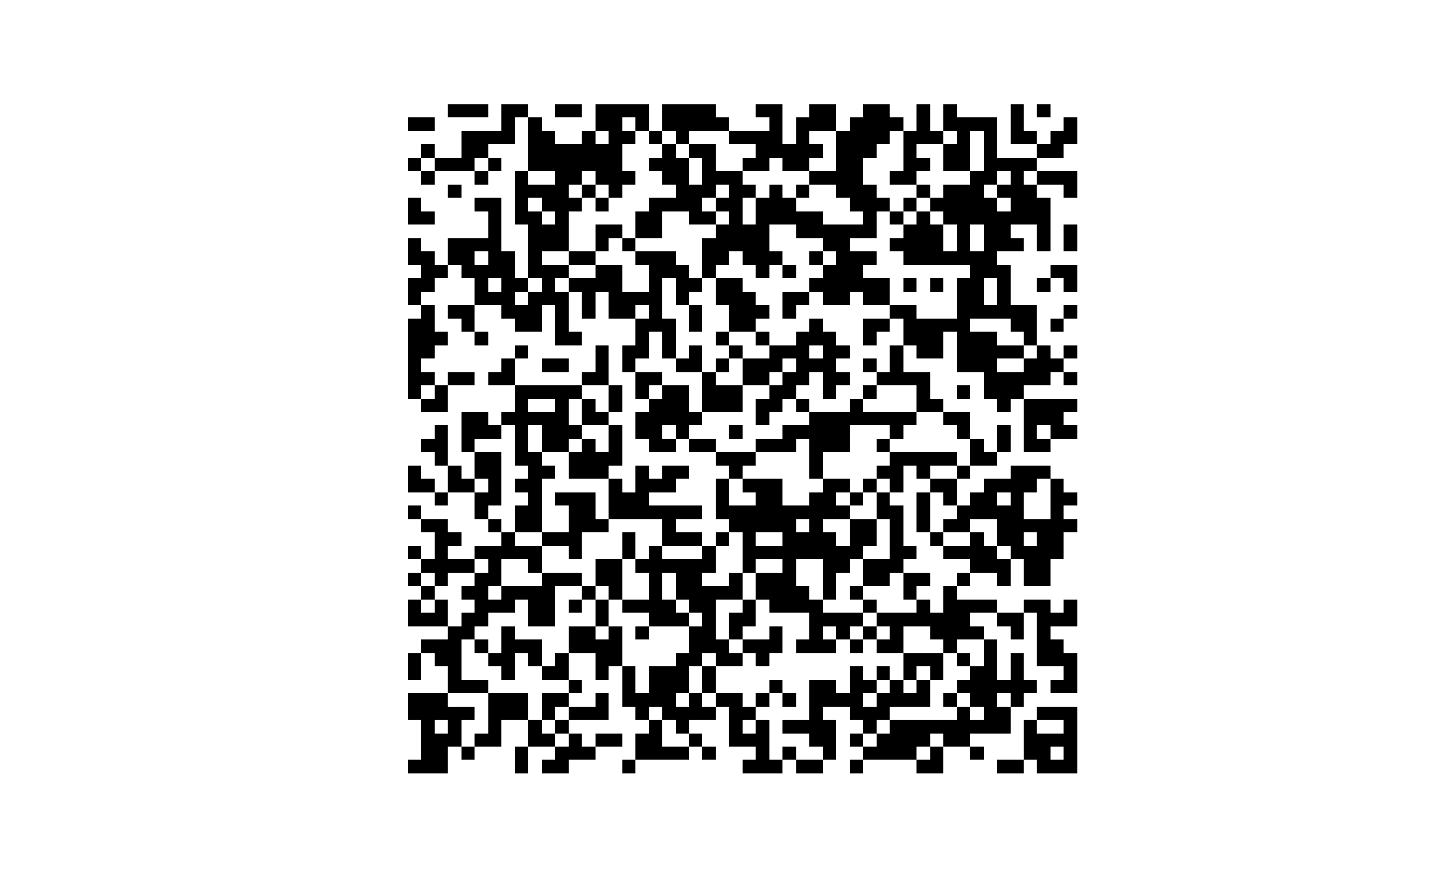
Grid Visualization

Slide 15
Conclusion
• Conway's Game of Life is a simple yet powerful simulation.
• It demonstrates how complex patterns can emerge from simple rules.
• You can experiment with different initial states and see various patterns evolve.
https://github.com/Sardar-Hassan661/Convey-s-game-of-Life/tree/main

